Slide 1


Robotics Workshop Semester 2 Introduction
Notes:
Hello everyone, its great to see so many of you here at this first session.
My name is Lukas, I organize and create theses workshops as a part of hackSussex.
Today well be going through what these workshops are and what you can expect over the next few weeks.
So the goal of these workshops is to teach you the basics of electronics, mechanics, coding and robotics in a fun and interactive way. Last semester we ran them weekly, where each session was structured around a group worksheet that would instruct you how to make something whilst learning about it.
Those worksheets were targeted at beginners and this semester we will be rerunning those beginners guided workshops in addition to introducing a new workshop style, the “DIY workshop” where you get to make anything you want with what we have if you stick to some rules.
Today’s guided workshop is taking place here in the FTL, this is so I have time to setup our more permeant location in the John Clifford West building where we will have access to 3D printers and other tools.
From next week all workshops will take place there. I will also be asking during this session what times would be best for the weekly workshops, so have a think when would best fit your timetable.
(Also be taking attendance/ recording peoples sussex emails)
Keep in mind, in this presentation I may mention things that you don’t yet understand, don’t worry if that is the case, I'm just giving you as much information as possible which you will hopefully start to understand over a few weeks.

Slide 2
Guided workshops
Weekly
Work through worksheets in groups
Create a cool thing
Learn about interesting devices and concepts
Hands on
Notes:
So, a bit more detail on the guided workshops, which is what we are doing today.
A normal 2 hour session would generally involve me talking for 5-10 minutes about the worksheet topic.
Then, in groups 2 – 4 you’d go through the worksheet with the provided hardware.
(Show worksheet and hardware)
While your working together, we’ll be walking around to provide help where needed.
The last 20 minutes or so will involve packing up the equipment and having a short Q&A.
We have all worksheets available at the front, so if you’re curious about what you'll be doing later, there here for you to look at.

Slide 3
DIY workshops
Weekly
Think of your own project idea or experiment
Use our range of available tools and resources to make it
Have fun and learn!
Notes:
So, a bit more detail on the DIY workshops
you will be able to think of your own project or experiment and make it. We have a wide range of micro-controllers / sensors / motors / materials and tools at your disposal to make your idea if it abides by some rules which we will talk about more in that workshop.
- Anything you make must be able to be taken apart, except for any mounts/frames or 3d printed parts. So you can glue a 3d printed mount onto a wooden plate, but any motors / sensors / electronics cant be glued on, but instead mounted with zip-ties, bolts or screws.
- Along similar lines, anything you make you can't take home, but feel free to keep it in our storage between sessions.
- Don’t break things on purpose, accidents happen, and we understand that, but significant neglect or abuse of the equipment will get you kicked out of these workshops.
- Lastly, be respectful, learn and have fun.
Over time I will be creating mini worksheets for every item we have, that will give you a good starting point of what it is and how to use it, for now feel free to ask google or me about how to use anything you don’t know.
Now, i understand the timings for these workshops may collide with lectures, which is why you will be able to do both Guided and DIY workshop activities in both weekly time slots, but the Wednesday sessions will be primarily focused on guided activities and Fridays on DIY activities.

Slide 4
What do we have?
Micro controllers: Arduino UNO/Nano, ESP32, Raspberry Pi Pico
Sensors: Ultrasonic distance, line following, IMU6050
Motors: DC wheel, Brushless propellor, 9g Servo, Nema 17 Stepper
Electronics: Breadboards, wires, resistors, capacitors, 555 timers
Materials: MDF, Acrylic, 3d Printer PLA, Cardboard, bolts/nuts, glue
Tools: Screwdrivers, Craft Knives, Spanners, Multimeters
Misc: 2S and 3S Lipo batteries, Access to laser cutters and 3D printers
Remote: IR transmitter/receiver, 6CH transmitter/Receiver, Wi-Fi via ESP32
Notes:
Here’s a quick list of some of the more notable items we have for you to play with.

Slide 5
What we’re doing today
Intro to Electronics
And / or
More Micro-controllers
Notes:
And now, what are we doing today?
Well, If this is your first session and you’ve never used electronics and microcontrollers before, you'll be doing the first worksheet to introduce you to the basics.
And the second worksheet is available if you finish quickly.
If you’ve already done this worksheet last semester or are already familiar with Pi Pico’s, I’ve created a QuickStart worksheet for Arduino’s and ESP32s where your challenge is to complete the existing worksheets but using those microcontrollers instead.

Slide 6
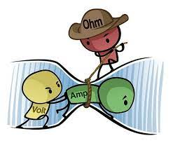
Basics of electricity
Voltage, V, measured in Volts
Current, I, measured in Amps
Resistance, R, measured in Ohms
Related by Ohm’s Law: V = I * R
Notes:
In electronics you have 3 variables key variables to think about when creating circuits. Current, which is a measure of the rate of flow of charge through a wire, electrons hold this charge, so current is a measure of the rate of flow of electrons through a wire.
Voltage, this is a measure of the potential for charge to flow through a wire, analogous to the potential a rock has at the top of a hill to roll down.
And resistance, simply a property that resists the flow of charge in a wire.
These 3 factors are all related to each other through Ohms law. Where voltage equals current multiplied by resistance.

Slide 7
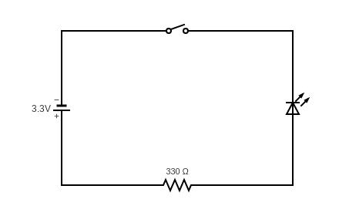
Basics of electricity
Notes:
This is a basic circuit diagram, on the top you have a switch, currently the switch is open so no current can flow.
On the left is a battery/power supply giving 3.3v, on the right is an LED.
LED stands for light emitting diode, diodes are electrical components that only allow electricity to flow in one direction, and with it being a light emitting diode it only emits light when its powered in one direction.
If you're still struggling with this concept there are some great resources on YouTube that can explain electricity a lot better than I can.

Slide 8
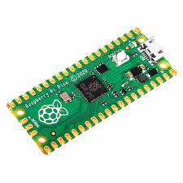
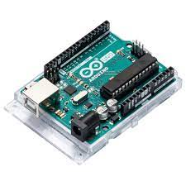
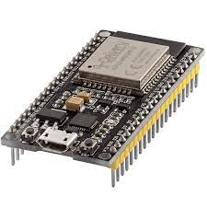
What is a micro controller?
Raspberry Pi Pico Arduino UNO ESP32 DevKit V1
Notes:
What is a micro-controller
A micro controller is a small device that lets you program and control its inputs and outputs in the form of electrical signals with code. All of these are different types of micro-controllers we have. The one on the left called a Raspberry Pi Pico it is perfect for beginners and is programmed in Python.
The middle one is called an Arduino UNO it is programmed in C++
And the right one is called an ESP32, it is also programmed in C++ but is more capable and slightly harder to use than an Arduino.
All of those golden tabs can be connected to wires, and then controlled with code.

Slide 9
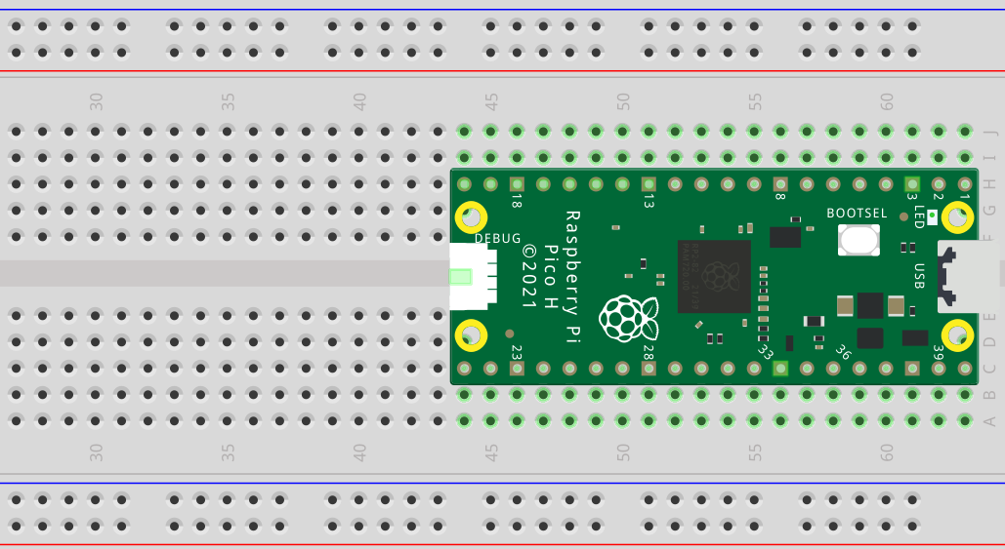
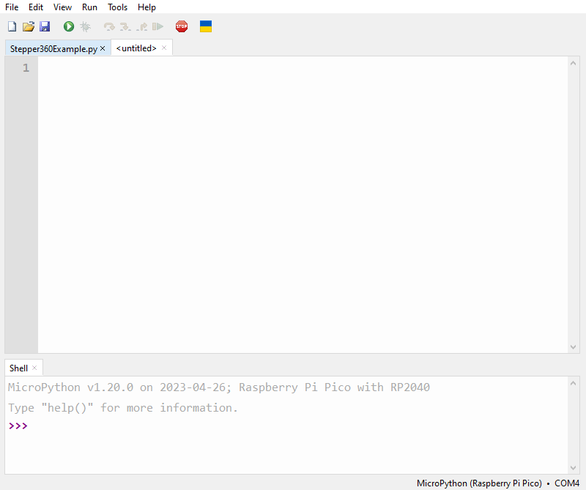
How to use the Pi Pico?
Hardware side Software side (Thonny)
Notes:
() – brackets indicate in person pointing out.
How do you use a Pi Pico?
On the hardware side you can connect the Pi Pico’s pins (all of these) to various devices with wires, however for most workshops your Pi Pico will be on a bread board (one of these).
These allow you to more easily connect and mount various electrical components together. They work by creating an electrical connection between pins plugged into the same row or column.
(all of these pins are electrically connected in a column, but these pins which are also connected in a column are not electrically connected to the coulomb above, and that’s the same across the whole center section)
(for the 2 rows at the top and bottom, these generally are used for power and ground because each row is electrically connected across the whole board)
Now on the software side when you connect your Pi Pico to a computer using the provided cables, and launch Thonny, you can write a program for the Pi Pico in Python then upload and run the code.
The worksheets have detailed instructions on how to connect and program the Pi Pico with Thonny so I wont go into any more detail here.

Slide 10
Already done the first worksheet?
I’ve made some new QuickStart worksheets for the Arduino and ESP32
Try doing the original worksheets for the Pi Pico using these micro-controllers as a challenge
If you’ve never used either of those before I would recommend trying the Arduino first

